Slide 1
Project – Smartphone Trucker Tracker
Problem Contextualization Adam Coetzee - 29982995

Slide 2
What is Fleet Tracker? Why is it important?
A full-stack live tracking solution using Android devices to track Truckers in a fleet
Provides managers of trucking companies a means to ensure truckers are
driving to the correct location
not stopping for excessive amounts of time
driving appropriately, in a steady manner at adequate speeds
Tracks acceleration, altitude, location and speed
Such information allows managers to ensure efficiency

Slide 3
Background – Trucking Industry
Trucking is essential for the economy
Fleets carry cargo over far distances
Misbehaving truckers are detrimental:
Excessive stop times
Unsafe driving
Managers can’t monitor them
A means of tracking is required

Slide 4
What to track?
Acceleration
Rapid acceleration/braking
Altitude
Optimization analysis
Location
Correct locations
Taking optimal routes
Speed
Obeying traffic laws
Driving optimal speeds

Slide 5
How to track? - Sensors
Acceleration
Accelerometers provide raw data with gravity
High pass filtering to remove gravity bias
Sensor fusion: gyroscopes/magnetometers can clear gravity bias
Altitude
GPS
Location
GPS
Speed
On-board vehicle speedometer
Location delta
IoT devices come with sensor suites

Slide 6
Problem Statement
Synthesize a tracking system for companies to track Acceleration, Altitude, Location and Speed captured with an IoT device
Continuously (or periodically) upload data to a central storage location
Provide an interface for managers to access this data, in a processed form which can be easily interpreted.

Slide 7
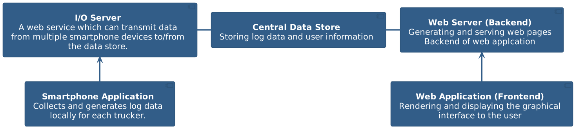
Hypothesis
On-board smartphone sensors
I/O server receives log data from multiple devices
Data stored in Data Store
Web server performs back-end logic serving web pages to web application
Front end of web application renders web pages to manager
Objective:
Use logged data to generate detailed reports conveying useful information to managers
Benefit:
Managers can ensure efficient and proper operation

Slide 8
Requirements
Smartphone Application
Identity Control
Log Acceleration, Altitude, Location and Speed every 2 minutes
Upload log data: Continuously or on request
Store log data locally until it can be transmitted to central store
Logging must take place in the background
I/O Server
Allow multiple Smartphone devices to simultaneously connect
Identity verification and control
Transmit log data into the central database
Data Store
High performance
Store all data pertaining to truckers and managers
Web Application
Support multiple managers and truckers
Generate detailed trip information about each trucker:
Start/Stop Locations with corresponding times
Delay between trips
Displa y

Slide 9
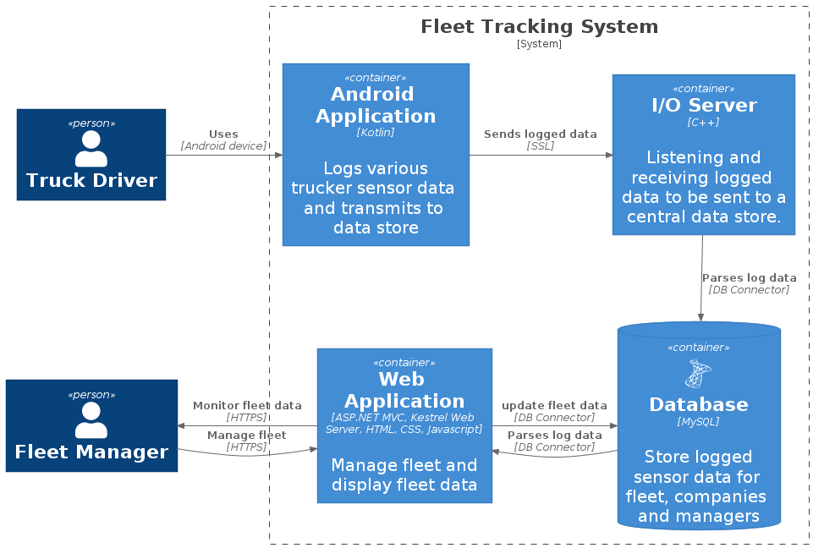
System components

Slide 10
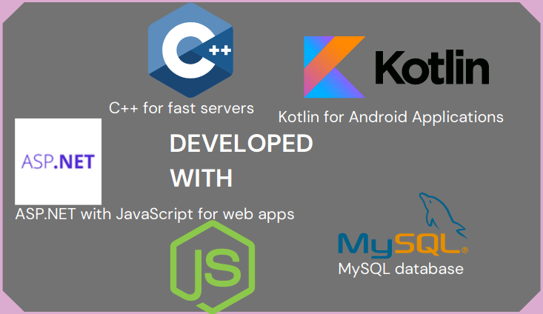
Technologies

Slide 11
Conclusion
System deployed (and tested) to a Linux VPS in docker containers
The required variables are logged (location accurate to 20m)
I/O server and web application maintain indefinite up-time (100%)
More testing required on Android Application, but runs well on Android 10
Further improvements to robustness and up-time can make this solution more reliable
Future expansion could include:
Added integration with on-board vehicle sensors
Improved algorithms and data processing for more accurate readings
Appealling solution for companies who want to use multipurpose devices, with cost-saving potential

Slide 12

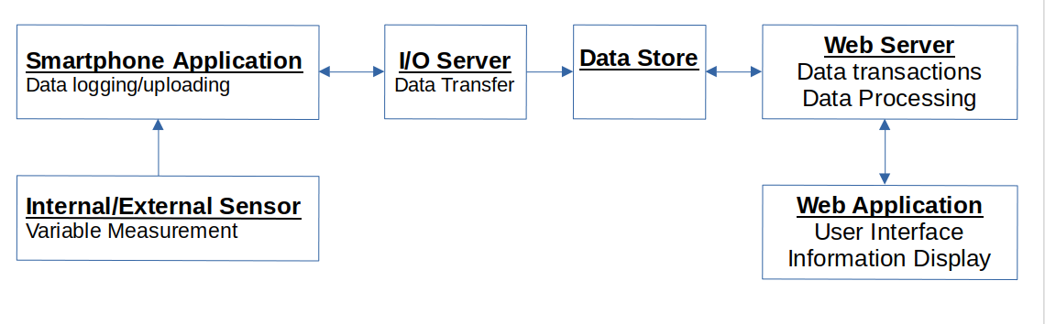
Smartphone Application
To be used by truckers
Log sensor data every 2 minutes
Send data to online server
Not responsible for generating reports

Slide 13
I/O Server
High speed interface between smartphone application and data store
Capable of handling many requests
Only meant for data transfer

Slide 14
Data Store
Storage Structure for trucking logs
Should be suited for many records
Compatiblity with system components

Slide 15
Web Server
Data store access
Data processing – generate daily reports:
locations travelled to
Transit Times
Stopping times
Speed etc.
Server requests to web application

Slide 16
Web Application
User Interface
Access reports about truckers

Slide 17
Conclusion
Deliverables
Smartphone Application
Web Application
Necessary supporting backend
Benefits
Improved monitoring
Potential optimization

